Slide 1
One Pass Select
A complete, fully integrated fitness and well-being solution

Slide 2
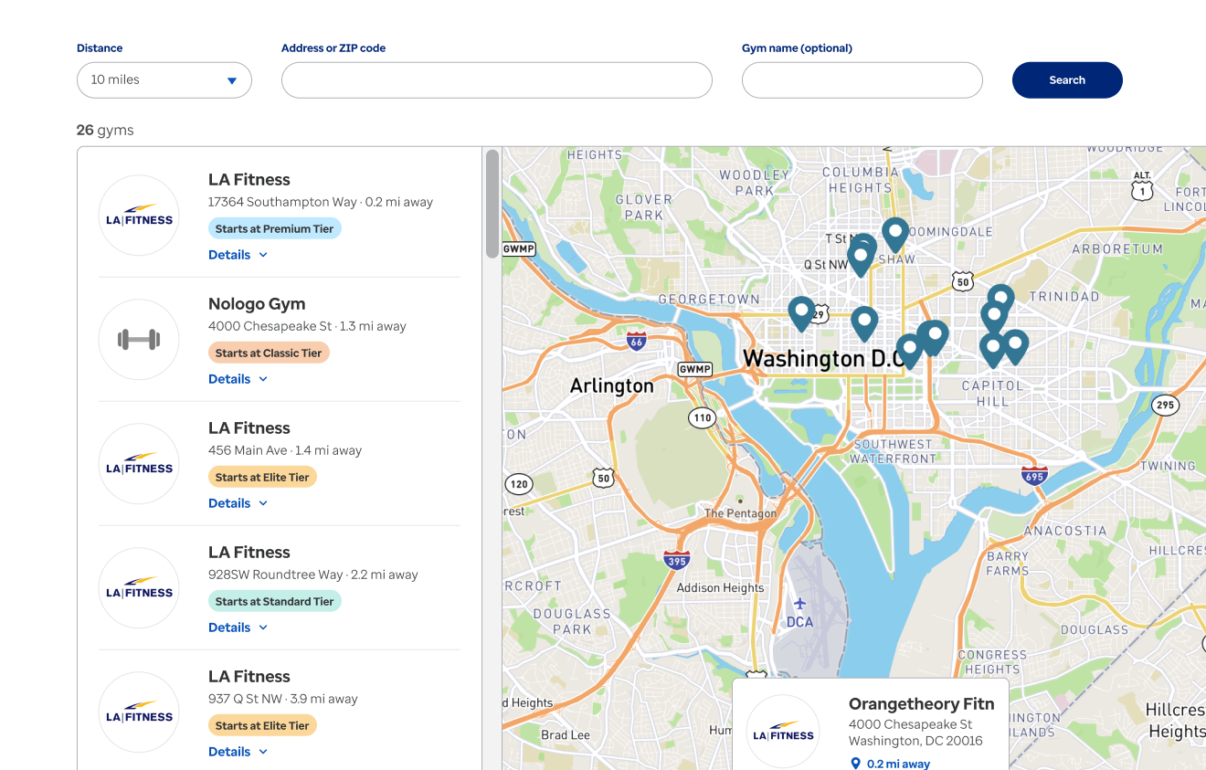
One Pass Select Program Overview Visit www.OnePassSelect.com today to browse locations and learn more
Fitness networks
20,000+ Gyms and boutique studios with multilocation access to all tier locations
Digital solutions
23,000+ on-demand & livestreaming fitness classes through web, app and TV, plus AI workout builder
Healthy meal delivery and Perks
Groceries and household essentials delivered directly to the member’s door
Engagement
Challenges and communities, activity and progress tracking, and digital coaching that adapts to member feedback

Slide 3
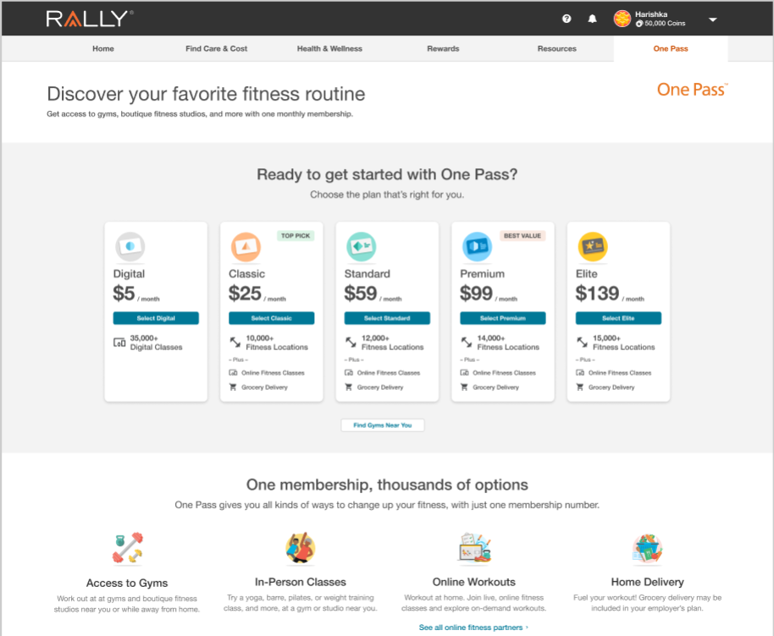
Choose the plan that’s right for you
No contracts; pay month-to-month
Cancel anytime (30-day notice)
Flexibility to change tiers monthly
Browse locations in each tier before deciding to purchase
Add unlimited friends & family (ages 18+) at a 10% discount
$10/ month
$29/ month
$64/ month
$144/ month
23,000 digital classes
11,000+ fitness locations
13,000+ fitness locations
15,000+ fitness locations
17,000+ fitness locations

Slide 4
A variety of membership options to fit lifestyle goals
Category | Digital | Classic | Standard | Premium | Elite
Monthly member fee | $10.00 | $29.00 | $64.00 | $99.00 | $144.00
Enrollment one-time member fee | $10.00 | $29.00 | $29.00 | $29.00 | $29.00
Gym network size |  | 12,000+ | 14,000+ | 16,500+ | 20,000+
Premium network
Multi-location access
Digital classes
On-demand
Livestreaming
Workout builder
Grocery delivery
Family membership (10% discount)
Upgrade/downgrade monthly
Cancel within 30 days

Slide 5
One Pass Select Partners
Digital (23k+)
Classic (12k)
Standard (14k+)
Premium (16k+)
Elite (20k+)

Slide 6
Your Perks Home delivery options
Free delivery from your chosen store
Free shipping with no order minimum
Video streaming from Paramount+ with over 40K episodes, hit movies and live sports
Member savings on fuel at 14K locations through Exxon, Mobil, Walmart and Murphy stations
Additional limited-time offerings
$98.00 annual value for free
$0 dollar delivery on orders >$35.00
National and local retailers: Bed Bath & Beyond, Costco, CVS, Harris Teeter, HEB, Meijer, Office Depot, Petco, Sephora, Target, and so many more.
Exclusive deals
$99.00 annual value for free

Slide 7
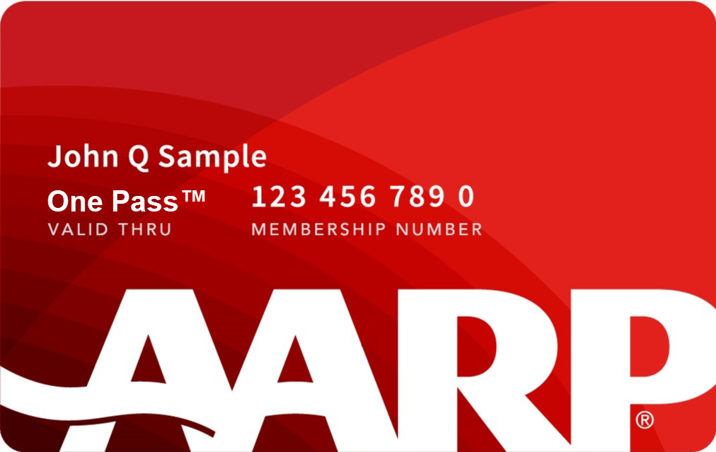
Your Perks: AARP Membership
AARP Benefits
One Pass Experience
Discounts on travel, dining and everyday purchases
Award-winning "AARP the Magazine“
Tools to help with everything from finances to healthy living
Exclusive products like dental, hearing and cell phone plans
Volunteer opportunities in your community
AARP Membership available to all ages
Personalized One Pass Membership card and enrollment kit sent to new and existing AARP members

Slide 8
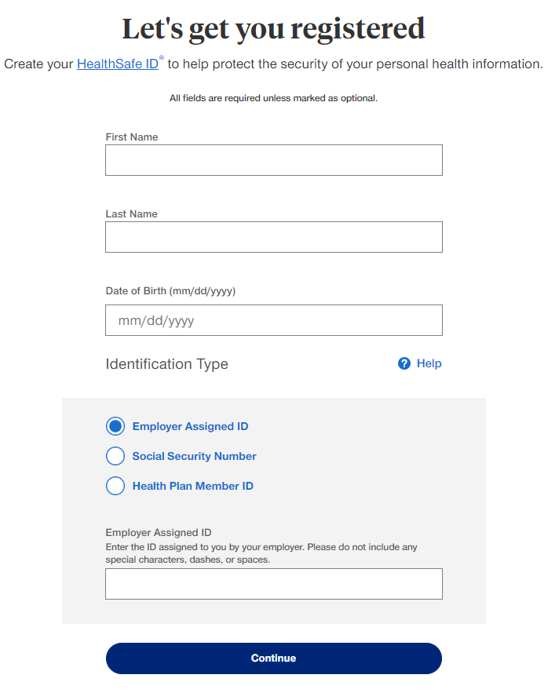
To sign up and enroll:
One Pass Select utilizes HealthSafe ID (HSID) for logging in, which is the same ID and login for those who use myuhc.com
UHC Members have two pathways:
Members can go directly to www.OnePassSelect.com and login using their HSID credentials. If you do not have one yet, follow the prompts to set one up; using the Health Plan ID option for verification.
Logging into www.myuhc.com > Additional Benefits > One Pass Select Tile
Non UHC Members:
Go to www.OnePassSelect.com > Click Get Started > follow prompts to create a HealthSafe ID, using your employer assigned ID for verification.
Tip: Your employer assigned ID is different from your UNI - it is an 8-digit number that can be found below your name on your paycheck. View Your paycheck by logging into PAC.
Notes:
Speak to: Columbia does not share SSN, so this will not be a viable way to register
Add a slide about membership being instant

Slide 9
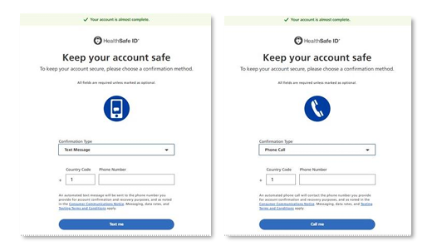
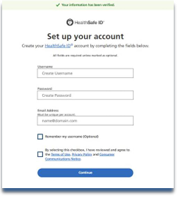
Multi Factor Authentication
Members will be prompted to keep their account safe (Multi Factor Authentication) by choosing to receive a code via text message or phone call.
They will enter their phone number and select “Text me” or “Call me.”

Slide 10
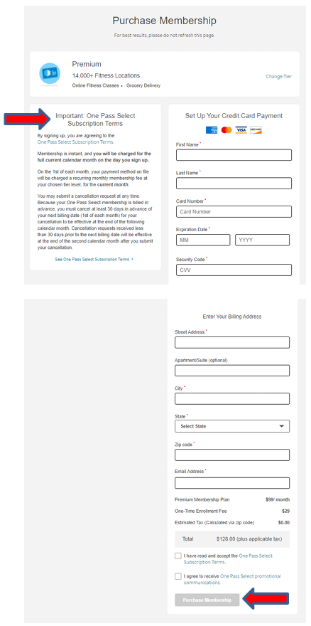
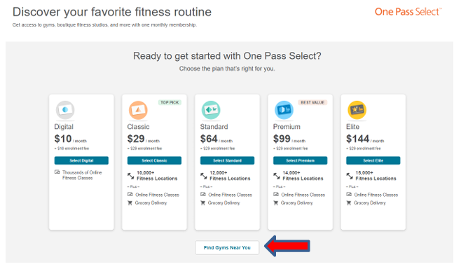
Membership and Billing
Tip:
Membership is instant and not pro-rated. You’ll be charged the full calendar month on the day you sign up.

Slide 11
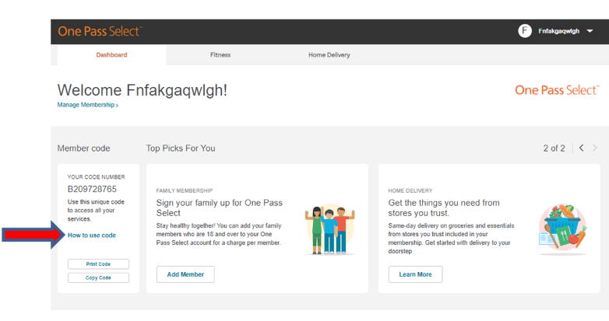
One Pass Select Portal Dashboard
Use your unique One Pass member code to sign up for all features of the program
Sign up unlimited family members or friends 18+
Search for facilities and digital partners
Upgrade/Downgrade or cancel membership by going to ‘Manage Membership’

Slide 12
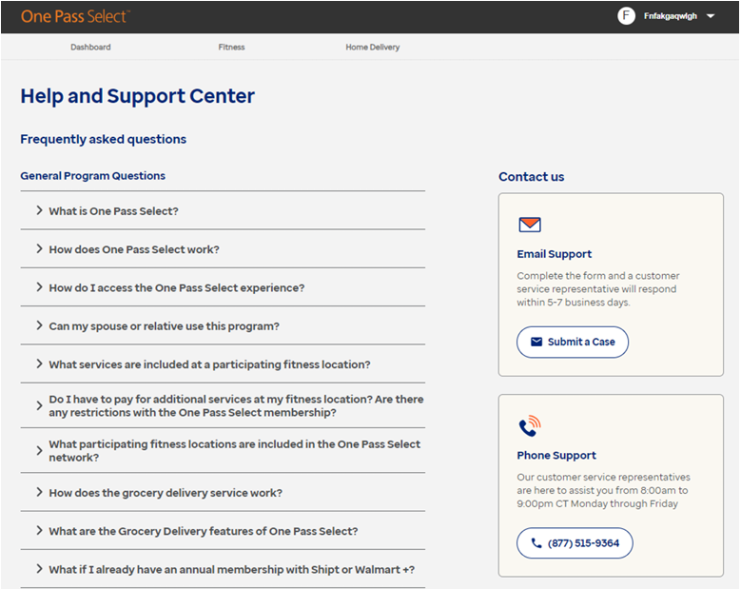
Have questions or need support?
Members can click on their name in the top right-hand corner of their experience and select “Help Center & FAQs
One Pass Select FAQs - www.OnePassSelect.com/faqs

