Slide 1


Bright Horizons College Coach
Notes:
Today we are going to be providing an overview to the Bright Horizons College Coach program. Whether you have a middle schooler or young highschooler and are starting to think about their college future or you have an upperclassman beginning the college planning and/or application process, this free benefit can help you as a parent and your student navigate through this exciting, but often challenging journey.

Slide 2

College Planning is Complex
30%
of parents are overwhelmed thinking about saving, with more than 40% losing sleep about college costs
32%
say that cost is a major factor in choosing a college
22%
amount of time public school counselors spend on college counseling
250:1
recommended high school students-to-college counselor ratio (national average is 482:1)
98%
of College Coach users recommend the valued benefit to a colleague
Notes:
There are a lot of complexities involved with College Planning,
30% of parents are overwhelmed thinking about saving, with more than 40% losing sleep about college costs
32% say that cost is a major factor in choosing a college
22% is the amount of time public school counselors spend on college counseling and the recommended high school students to college counselor ratio is 250:1 but the national average is 482:1
While I know that there are some steller school counselors, generally speaking, school counselors have a lot on plate and a lot of students to support.
And that is where Bright Horizons College Coach can help. College Coach provides access to tools, resources, and expert support to help you and your student navigate these complexities
And this benefit is so widely popular by our users, that 98% would recommend the benefit to a colleague.

Slide 3


Bright Horizons College Coach
Navigate the road to college with your child.
Your free benefit can help.
Are you wondering how best you can pay for your student’s college expenses?
Do you have a high school student getting ready to start the college admissions process?
Are you concerned about your student’s ability to succeed in school?
Notes:
Whether you a high school student getting ready to start the college admissions process, you are concerned about your students ability to succeed in school, or you are worried about how you can navigate College finance challenges, your free Bright Horizons College Coach benefit provided by your employer can help.

Slide 4
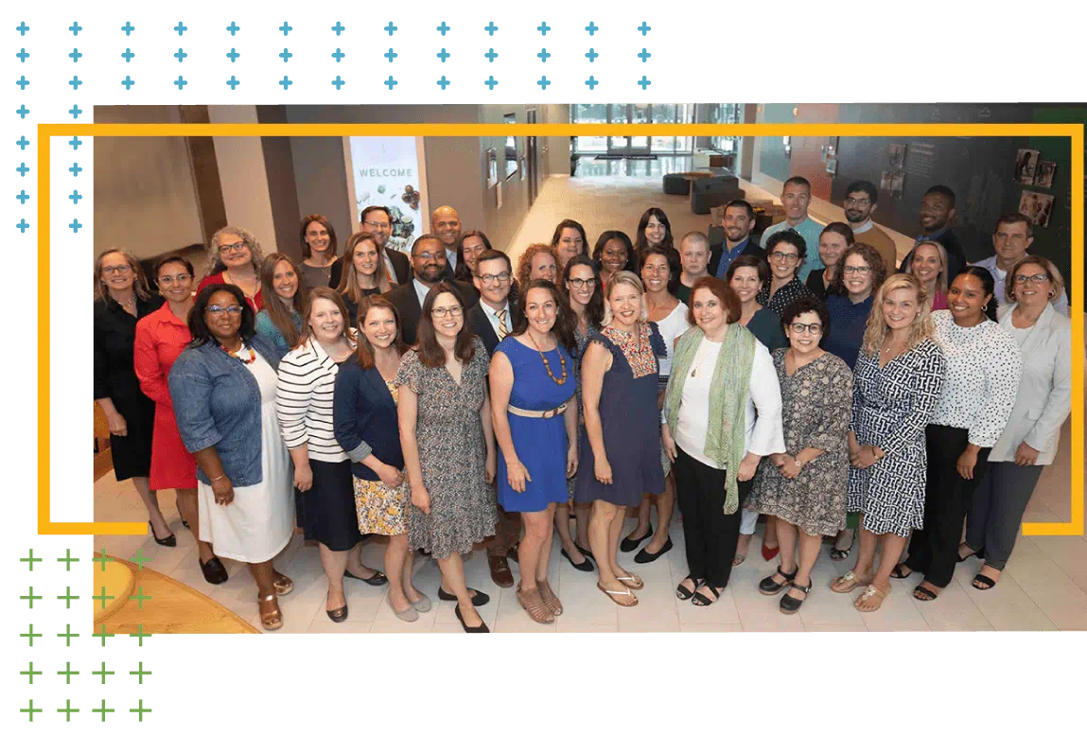
A team of world-class experts
Nearly 70 experts with 900+ collective years of experience in college admissions and finance
Decided on more than 525,000 admissions applications
Granted more than $2.5 billion in financial aid to students
Reviewed more than 650K essays
Additional elementary and secondary school experience
Notes:
Our College Coach program is backed by our team of world-class experts with over 900 collective years of experience in college admissions and college finance.
They come with experience from more than 70 institutions including:
Boston College
Brown
Cornell
Drexel
Fordham
Northeastern
Stanford
UC Boulder
UC San Diego
UNC Chapel Hill
U Portland
They have decided on over 525 thousand applications, granted more than $2.5 billion in financial aid to students, reviewed more than 650 thousand essays, and have additional experience in elementary and secondary schools.
College Coach does not sell investment products, recruit for colleges, or benefit financially from the planning decisions families make. Our goal is to provide unbiased information that families will find empowering and which they may not receive from other sources.

Slide 5
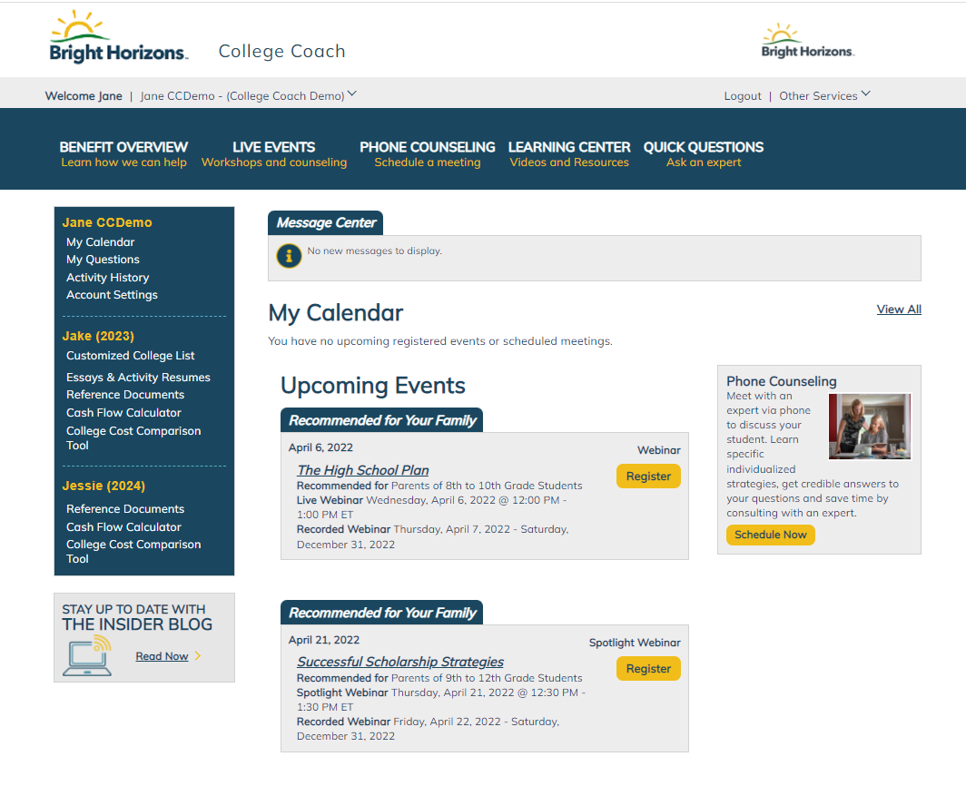



Comprehensive College Advising
EXPERT GUIDANCE
Personalized help with admissions, essay reviews, college finance, and more
INSIDER WORKSHOPS
Sharing strategies and debunking myths for every phase of a child's education
POWERFUL TOOLS
Videos, cost calculators, and FAQs - available for the entire family
“Navigating the complicated college prep process with my teen is overwhelming, but this benefit is fantastic! The webinars are great for learning about the smaller details, while one-on-one consulting helps us with the bigger picture.”
-Parent of an 11th Grader
Notes:
Your benefit gives you access to expert guidance from a team of former admissions officers and college finance professionals. Employees who have taken advantage of this benefit say that College Coach helped reduce their stress, save them time and money and achieved outcomes they couldn’t have imagined on their own.
Bright Horizons College Coach provides resources to maximize your child’s academic success through multi-level approach that includes webinars, an online learning center, and personalized assistance from our experts. Register on our easy-to-use portal to get free access to:
Live Events which include 60-90 minute presentations highlighting important college preparation and financial topics.
Through your employer benefit, you have exclusive access to experts who are former admissions and financial aid officers at colleges throughout the country, who offer the impartial guidance you need to help your child succeed. Includes one-on-one sessions, college list development, essay reviews, and answers to quick questions submitted on the portal.
The online Learning Center is full of interactive videos, tools, and resources targeted to your student’s age and available to access at your convenience for you and your family members.
It’s never too early to register for Bright Horizons College Coach as helpful resources such as webinars and online content include topics for all support ages for your children.

Slide 6
Insider Workshops: Webinar Schedule
Learn about important college admissions and finance strategies, along with other education-related topics, in our 60-90 minute seminars offered throughout the year. Each live event is presented via webinar and features an interactive Q&A session with the speaker. Webinar recordings will be made available for 30 days following the event.
Date/Time | Topic | Recommended For
October 11, 2023 at 12:30 PM | Navigating the FAFSA and Other Financial Aid Applications | 12th grade
November 9, 2023 at 3:00 PM | Alternatives to a 4-Year Degree | 9th - 12th grade
December 12, 2023 at 12:00 PM | PSAT – What a Score Means, Why It Matters | 8th – 11th grade
January 18, 2024 at 3:00 PM | The High School Plan | 8th – 10th grade
January 30, 2024 at 12:00 PM | Paying for College | 9th – 12th grade
March 6, 2024 at 12:00 PM | SAT & ACT: Which is Right for My Child? | 9th – 12th grade
April 3, 2024 at 12:00 PM | New Era of Digital Exams: Changes to the SAT, ACT, and More | 9th – 12th grade
May 21, 2024 at 3:00 PM | Selecting Best Fit Colleges | 11th grade
June 13, 2024 at 12:30 PM | The Successful Transition to College | 12th grade
July 10, 2024 at 7:00 PM | Writing Your Best College Essay | 12th grade
July 16, 2024 at 12:00 PM | College Admissions Tests: When and How to Start | 9th – 12th grade
Notes:
College Coach is one of our most highly acclaimed benefits. Families who have worked with College Coach are often eager to share testimonials. Families say they are lucky to have support through their employer through super useful benefits like College Coach. The benefit reduces stress, and saves time.

Slide 7

Preparing for College Early On
9th – 10th Grade
Meet with Bright Horizons College Coach advisors to discuss academic and extracurricular opportunities during high school, and plan ahead for paying for college
Meet with school counselors annually to discuss the following year course selection
Explore interests or hobbies for summer
Read!
Prepare for and take AP/IB exams (if applicable)
Notes:
College Coach can help your student plan and prepare for college applications as it relates to admission and finance. FRESHMAN YEAR - Students who start with College Coach right from freshman year can make smart curriculum and extracurricular choices with future admissions in mind. We'll get students thinking about goals, introduce the concepts of college finance, and lay the groundwork for summer activity options, standardized testing, organizational tips, how to do a college visit – everything to make the experience successful. Plus, starting early allows our college finance experts the chance to help your family gain an understanding of the college-based merit scholarship process and how to align your student's high school plan toward achieving these awards.
SOPHOMORE YEAR - With a year of high school behind students, the focus is on achievements, and how grades, rigor, and activities, will shape admissions. We'll also continue the application planning process – choosing 11th-grade curriculum, selecting activities, and considering standardized testing plans. And now's the time to start researching colleges and making informal visits. If you haven't already, we can direct you to one of our College Coach finance experts to talk about the college finance process.
These years are great opportunities for exploring interests and hobbies during the summers, and for reading. Reading helps students develop skills that will benefit them on their college essays.

Slide 8
11th Grade – A Full Year of Preparation
Fall:
Winter:
Update academic, extracurricular, and personal goals
Strengthen extracurricular and community involvement
Register for and take PSAT & AP/IB exams (if applicable)
Plan for summer internships and community involvement
Start researching colleges
Begin to search for scholarships
Meet with College Coach to plan for senior year courses
Meet with College Coach to put together a plan to pay for college
Spring:
Summer:
Dedicate time for college research and build college lists
Begin planning campus visits
Utilize the calculator on college websites to anticipate aid eligibility
Take ACT or SAT & AP/IB exams (if applicable)
Beat the rush – ask teachers/counselor for letters of recommendation
Participate in a summer opportunity that deepens your interests
Request a copy of your high school transcript and make sure it’s accurate
Begin writing essays and use the essay review service
Sign up for and complete college visits
Schedule interviews (if available)
Create application accounts and start applications
Read -- many colleges ask applicants about their favorite books
Notes:
Junior year is here, and at last the college list is available. We will handpick schools for your student, divided by likelihood of acceptance. Our college finance experts can assist with the list to incorporate affordability and school-based merit scholarship opportunities. We will also work with the student on self-assessment activities, essay writing, and curriculum planning to keep the process on track. Other items on the junior-year list: extracurricular performance reviews, standardized tests schedules and strategies, private scholarship search support, summer activity planning, teacher recommendation plans, understanding eligibility for need-based aid, plus tips for making college visits count.

Slide 9
12th Grade – The Final Year of Preparation
Fall:
Winter:
Register for and take ACT or SAT (if applicable)
Common Application opens August 1
Attend information sessions held by admissions representatives visiting your high school (if available)
Schedule interviews (if available)
Revise college essays, leaving time for multiple drafts
Complete and submit early admission/early decision applications if applicable (typical deadline November 1)
File financial aid applications (available October 1)
Submit any remaining applications (typical deadline January 1 or 15)
Confirm that your applications are complete
Check your email regularly for communication from colleges
Spring:
Visit colleges to which you’ve been accepted
Make a final decision and pay deposit by May 1
Notify all other colleges that you are declining their offer of admission and/or waitlist
Thank and notify your teachers and school counselor of your decision
Send final transcript to your chosen college
Notes:
It's here senior year, the home stretch. Our goal is to tackle the last push with a deadline-driven strategic plan that will get your student to the finish line...on time. And we're here to help with all the important final elements – last standardized tests, polishing up activity resumes and essays, maximizing scholarships, interview prep, and more. Finally — dot those last "i"s and submit those applications!
Then finally come DECISIONS! Congratulations it’s time to make your choice. Our consulting doesn't end when envelopes arrive. Look to your College Coach expert for help considering waitlists and making final decisions. Plus, College Coach finance experts can assist with comparing offers, payment strategies, and even negotiating/appealing financial aid decisions.

Slide 10

Virtual Tutoring Through Back-Up
Help your student stay on track, get ahead, or prep for entrance exams with one-on-one tutoring through Back-Up Care.
  Private (1-on-1 tutoring)
  Small Group
  Test Prep (ACT, SAT, PSAT, and AP exam instructions and practice tests)
  Homework Help
Support for students 5+ including college students and adult learners
Each 8 hour back-up care use exchange provides 4 hours of virtual tutoring
Employees have access to 200 days of back-up care per school year
© 2022 Bright Horizons Family Solutions LLC
Notes:
Your Bright Horizons benefits also provide some additional academic support resources that may be particularly useful for your College bound student.
Tutoring through back-up care can be accessed through exchange of your subsidized back-up care benefit for online tutoring sessions.
Additionally discounted tutoring, test prep, and homework help are available through Sylvan Learning at a 15% discount, and Revolution Prep and Varsity Tutors at 20% discount

Slide 11

Why Columbia University Families Love College Coach
  “The college admissions process has changed so much in the past 20+ years since I applied for undergraduate that this resource has been essential to catch me up with changes to the college landscape. My child goes to a large public health school and her counselor did not have the breadth of experience or time to provide the advice and help we needed during this process. The college coach staff had so much experience, were so kind, knowledgeable, and available. It was wonderful! Highly recommend.”
“One of the most considerate and helpful benefits my employer offers. Could not be happier with this benefit and the level of service associated with it.”
“The college admission process is so daunting and the stakes are so high that having an expert you can contact with questions is extremely helpful."
“Alleviating the stress is more helpful than most people realize. I am sure we wouldn't have been as successful without the help we received from College Coach.”
Notes:
College Coach is one of our most highly acclaimed benefits. Families who have worked with College Coach are often eager to share testimonials. Families say they are lucky to have support through their employer through super useful benefits like College Coach. The benefit reduces stress, and saves time.

Slide 12


Get Started With College Coach Today!
https://passport.getintocollege.com
Employer Username: Columbia / Employer Password: Benefits4You
Questions? Call: 888-527-3550 or email columbia@getintocollege.com
12
Notes:
Here at Bright Horizons College Coach, we are excited to help support you and your student. To get started, visit clients.brighthorizons.com/hp or if you have any questions or problems, you can reach us at 866-881-5235.
We look forward to helping you managing the admissions and finance journey soon!

